Slide 1
Team Ink3D Architecture Design Specification Review
Daniel Lain
Tim Edmonson
Shawn Simonson
Jesse Bowles

Slide 2
Outline
Vision
Guiding Principles
Layer Overview
Detailed Layer Subsystem Descriptions

Slide 3
Architectural Vision
Software system for unknown hardware implementation
Multiple materials
Evolution of Hardware and Software
Guiding Principles
Modularity
Configurability
Extensibility
Portability

Slide 4
Guiding Principle
Modularity
Layer replacement
Loose coupling
Design implications
Interfaces defined
High cohesion
Unidirectional data flows
Abstraction

Slide 5
Guiding Principle
Configurability
Printer Configurability
Print Configurability
Material Configurability
Design implications
Package interfaces
Configuration pass through
Concrete implementation selection

Slide 6
Guiding Principle
Extensibility
Reusable sub-systems
Need to add future sub-systems
Maintainable codebase
Design implications
Abstract interfaces
Composite configurations
Establish frameworks

Slide 7
Layer Structure

Slide 8
User Interface Layer
Interface to user
Import Files
Configure Materials
Configure Printer
Initiate Print
Pause / Resume
Printer Status
Packages Print Data for Preprocessing
Expectations
User Input
Printer feedback

Slide 9
Preprocessing Layer
Interface to processing layer
Translates data format
Re-Packages Print Data for Processing
Expectations
Standard format object file
Configuration data

Slide 10
Processing Layer
Slice and generate G-Code
Translates object file to path
Packages G-Code and Configuration
Expectations
Normalized object data
Configuration data

Slide 11
Post-Processing Layer
G-Code Preparation
Prepare G-Code based on configuration
Re-Packages G-Code and Configuration
Expectations
Standard G-Code path
Configuration data

Slide 12
Physical Layer
Printer Interface
Printer state control
Packet preparation
Provides
Pause / Resume
Instruction stream
Expectations
Printer specific G-Code path
Configuration data

Slide 13
Printer Feedback Layer
Printer monitoring
Status collection
Provides
Status Notification
State Change Notification
Expectations
Printer Status

Slide 14
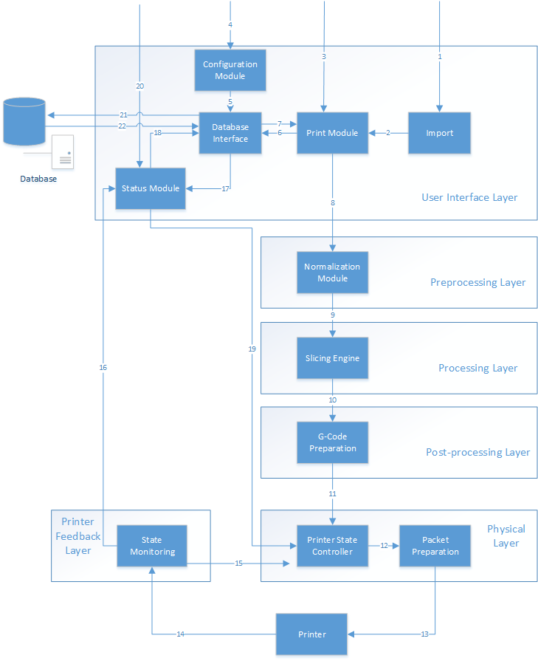
Layer Subsystem Overview

Slide 15
User Interface Layer Subsystems

Slide 16
User Interface Layer Subsystems
Import Module
Purpose: Allow the user to import object files
Function: Display interface from which users import files and pass those files to the Print Module.
Dependencies: Print Module
Processing: Create reference to an object file.
Input: Object File Name
Output: Object File Reference

Slide 17
User Interface Layer Subsystems
Print Module
Purpose: Allow user to set print specific settings and initiate a print job.
Function: Display interface from which users can set print settings and initiate a print. Pass the necessary information to the Preprocessing Layer when a print is initiated.
Dependencies: Database Interface
Processing: Map materials to object files. Package print request object.
Input: Print Settings, Printer Configuration, Material Data, Object File References
Output: Print Packet (Encapsulates Print Settings, Printer Configuration, Material Data, Object File References)

Slide 18
User Interface Layer Subsystems
Configuration Module
Purpose: Allow the user to configure printer settings and material information.
Function: Display interface from which users can input printer configuration and material information. Pass information to the Database Interface to be saved.
Dependencies: Database Interface
Processing: User Input Processing
Input: Printer Configuration Data, Material Data
Output: Printer Configuration Data, Material Data

Slide 19
User Interface Layer Subsystems
Database Interface
Purpose: Abstract data persistence
Function: Receive data from other modules and store it in a database. Retrieve data from the database for other modules.
Dependencies: None
Processing: Database query generation
Input: Configuration Information
Output: CRUD Operations, Configuration Information

Slide 20
User Interface Layer Subsystems
Status Module
Purpose: Display printer status information to the user and allow the user to stop/pause/resume a print job.
Function: Interpret data from the Printer Feedback Layer and display the data to the user. Send stop/pause/resume commands to the Physical Layer.
Processing: User Input Processing
Input: Stop/Pause/Resume User Input, Printer State Data, Configuration Data
Output: Stop/Pause/Resume Command

Slide 21
Preprocessing Layer Subsystems

Slide 22
Preprocessing Layer Subsystems
Normalization Module
Purpose: Provide a uniform interface between the Print Module and the Processing Layer.
Function: Translate and repackage the print request object in to the format that the processing layer needs
Dependencies: Print Module
Processing: Normalizes Object File
Input: Packet of Files
The Object(s)
Material(s)
Printer Configuration
Output: Packet of Files
Normalized Object
Definition
Print Configuration

Slide 23
Processing Layer Subsystems

Slide 24
Processing Layer Subsystems
Slicing Engine
Purpose: Create a set of instructions for the print job
Function: Uses the Object File to create a printing path.
Dependencies: Normalization Module
Processing: Slices object into layers
Input: Packet of Files
Normalized Object
Definition
Print Configuration
Output: Packet of Files
G-Code
Print Configuration

Slide 25
Post Processing Layer Subsystems

Slide 26
Post Processing Layer Subsystems
G-Code Preparation
Purpose: To modify the instructions for the printer to accept.
Function: Adds instructions for unique commands for the particular printer
Dependencies: Slicing Engine
Processing: Modifies G-Code
Input: Packet of Files
G-Code
Print Configuration
Output: Packet of Files
G-Code
Print Configuration

Slide 27
Physical Layer Subsystems

Slide 28
Physical Layer Subsystems
Printer State Controller
Purpose: To conditionally dispatch G-Codes to packet preparation module based on printer and operator state.
Function: Accept status inputs from status module and printer state monitoring and conditionally dispatches G-Code stream to packet preparation module.
Dependencies: Packet preparation module, status module, and printer state monitoring module.
Processing: May insert G-codes to halt the print if necessary.
Input: Error State, Packet of Files
G-Code
Print Configuration
Output: G-Code

Slide 29
Physical Layer Subsystems
Packet Preparation
Purpose: Convert G-Code stream into byte-stream for printer.
Function: Serialize G-Code stream and packetize so that the packets can be transmitted to the printer. Establish serial connection to printer firmware.
Dependencies: Printer state controller.
Processing: Serialization of G-Code stream. Chunk serialized G-Code stream into packets to be sent to printer firmware.
Input: G-Code
Output: Bits on a Wire

Slide 30
Printer Feedback Layer Subsystems

Slide 31
Printer Feedback Layer Subsystems
State Monitoring
Purpose: To monitor the operating status of the printer hardware.
Function: Listens for response from printer on established serial connection. Assembles and converts received data into form appropriate for inter-layer transmission.
Dependencies: Printer State Controller, Status Module
Processing: Data conversion from printer byte-stream into data structure suitable for transmission to other layers in the system.
Input: State Info
Output: Error State, State Info

Slide 32
Questions?

